Slide 1
Introduction to Research Data Management, including Data Curation Lifecycle Theory
Day 1

Slide 2
What this session will include:
What is Data Curation
Why do data curation?
Core Concepts in Data Curation
Management
Presentation
Preservation
Overview of Life Cycle models
DCC
OAIS
Notes:
This will give us a shared vocabulary, and a point of reference for the rest of the workshop … if you take notes –start now

Slide 3
Excel
title | type | properties.firstName.type | properties.lastName.type | properties.age.description | properties.age.type | properties.age.minimum | required.0 | required.1
Example Schema | object | string | string | Age in years | integer | 0 | firstName | lastName
CSV
title,type,properties.firstName.type,properties.lastName.type,properties.age.description,properties.age.type,properties.age.minimum,required.0,required.1
Example Schema,object,string,string,Age in years,integer,0,firstName,lastName
JSON
{
"title": "Example Schema",
"type": "object", "properties":
“firstName": { "type": "string" }, "lastName": { "type": "string" }, ‘
"age": { "description": "Age in years", "type": "integer", "minimum": 0}
"required": ["firstName", "lastName"]
}
Notes:
The same data – different formatting.
Which of these is the best option ?????
Trick question – it depends on who is using it…

Slide 4
“The active and on-going management of data through its lifecycle of use, including preservation and re-use”
GLSIS Definition

Slide 5
“The active and on-going management of data through its lifecycle of use, including preservation and re-use”
GLSIS Definition

Slide 6
Why do data management and curation?

Slide 7
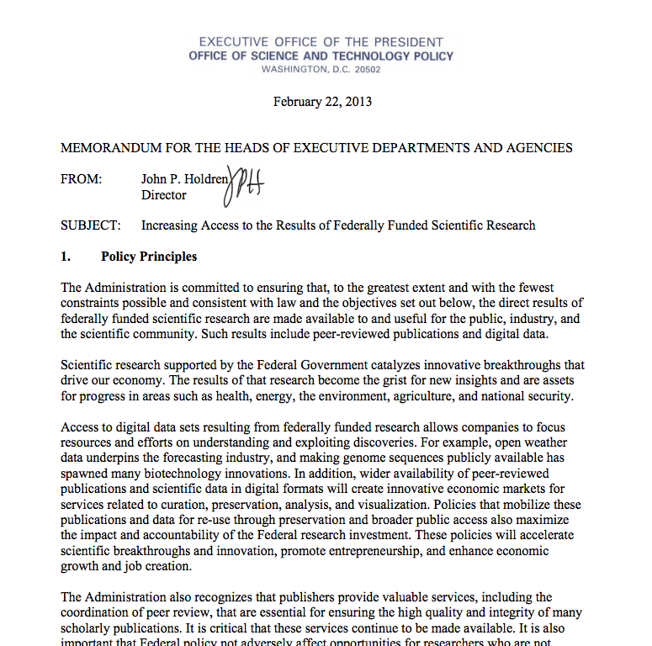

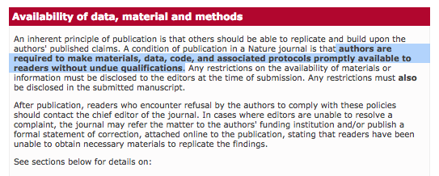
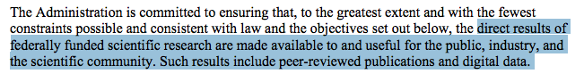
Federal
Journals & Professional Societies
Notes:
Policy…
This is about creating integrity

Slide 8
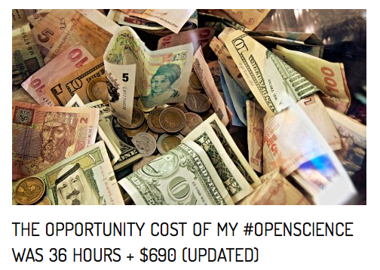
Includes time to:
Create metadata
Reformat, clean data
Archive data
Clean, comment, and refactor code
Create code repository + archive
That is a large amount of time from
a public employee whose salary is
high and expertise unrivaled…
http://brunalab.org/blog/2014/09/04/the-opportunity-cost-of-my-openscience-was-35-hours-690/
Notes:
Financial
We should want to improve this process, not only because it saves money ,,, but because it is the only tenable way to move research forward… think about how much time our students will spend doing these activities as the result of federal initatives

Slide 9
Cost including salary: $2948
Cost of publication in Open Access journal:
~ $ 3000
Fully reproducible, open access research product – code, data, and publication is (at least) : $6000
Notes:
The price to the university includes his salary too…. So
http://www.ir.ufl.edu/factbook/v-14_salaries.pdf

Slide 10
Core Concepts - Data -Curation -Management -Presentation -Preservation
Notes:
It helps to understand – first – what we mean when we talk about data, and what we mean when we talk about curation

Slide 11
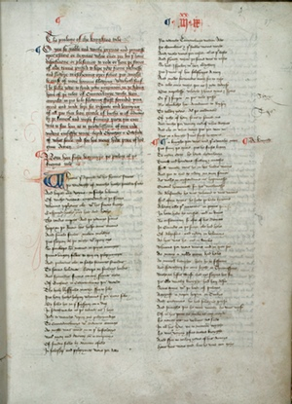
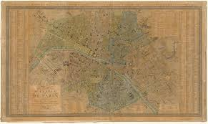
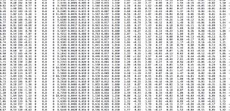
Data
Can include many different types of information objects:

Slide 12
Research Data
Research data are the informational resources that scholars draw on in doing research, supporting their findings, and producing new knowledge.

Slide 13
Scientific Data
… support the making of new knowledge claims.
… are the result of purposeful observation, experimentation, and simulation.
… are encoded and described with the aim of supporting retrieval, meaningful interpretation, use, and reuse (Wickett et al. 2012).
Notes:
Note that in this definition we do not make a distinction about these informational resources being digital; research data could include any number of physical objects, such as a biological specimen, an architectural blue print, a paper map, etc.
The focus of this workshop will be on the curation of digital data. However, there are times when it is necessary to consider how digital data are linked to other forms of physical data - as we discuss in later sessions related to provenance and workflow technologies.
The verifiability, and validity of a new knowledge claim within most scientific domains is often dependent upon access to underlying data - which makes the curation of this material a vital part of contemporary scientific practice.

Slide 14
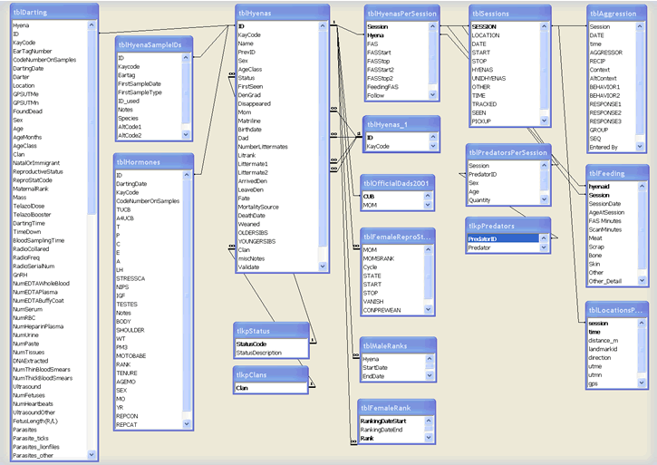
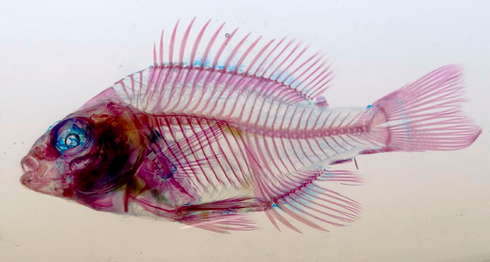
Scientific Data
Digitized physical materials
Born-digital data
Notes:
Our focus is on digital data…

Slide 15
Humanities Data
… are the starting point of argumentation within a community.
…often have propositions that are closely linked to their production
( how texts were transcribed, what was depicted, etc.)

Slide 16
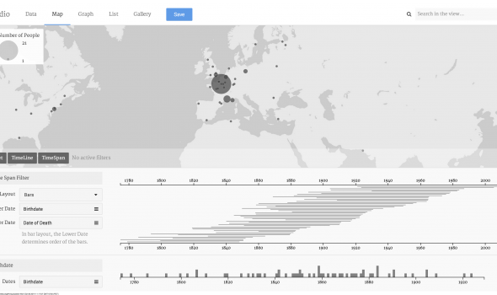
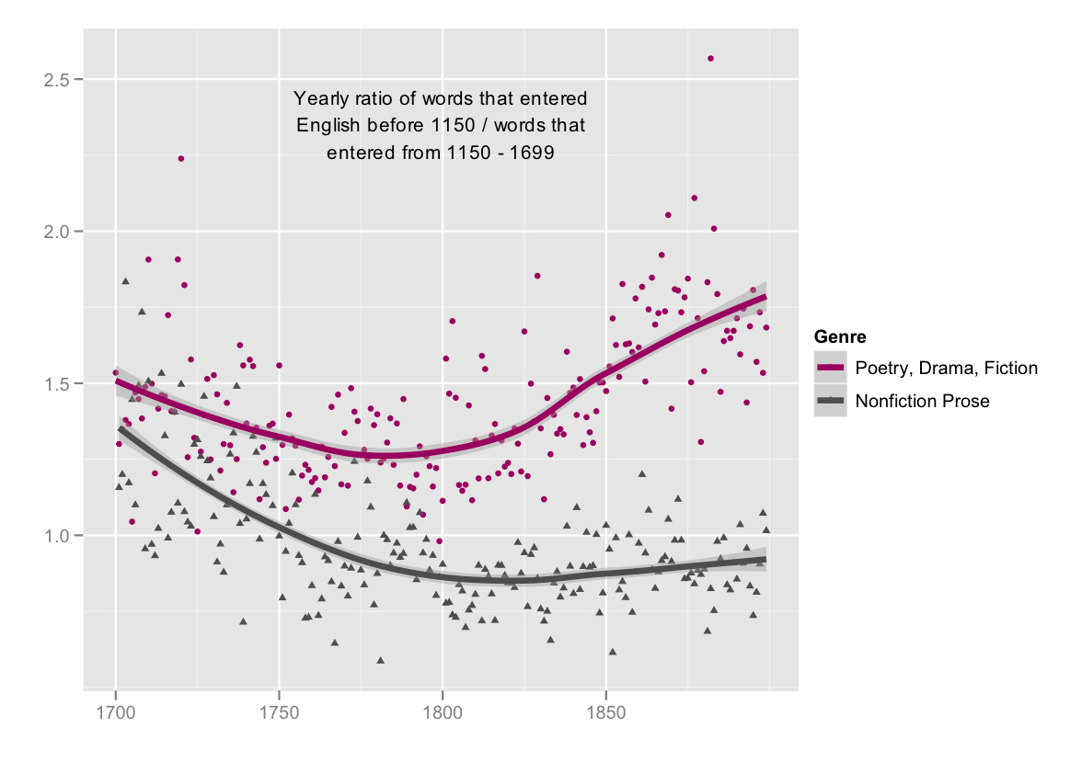
Humanities Data
journalofdigitalhumanities.org/1-2/the-emergence-of-literary-diction-by-ted-underwood-and-jordan-sellers/
http://hestia.open.ac.uk/palladio-humanities-thinking-about-data-visualization/

Slide 17
Data “types”
Documents (text, Word), spreadsheets
Laboratory notebooks, field notebooks, diaries
Questionnaires, transcripts, codebooks
Audiotapes, videotapes
Photographs, films
Test responses
Slides, artefacts, specimens, samples
Collection of digital objects acquired and generated during the process of research
Statistical or other data files
Database contents (video, audio, text, images)
Models, algorithms, scripts
Contents of an application (input, output, logfiles for analysis software, simulation software, schemas)
Methodologies and workflows
Standard operating procedures and protocols
http://datalib.edina.ac.uk/mantra/researchdataexplained/

Slide 18
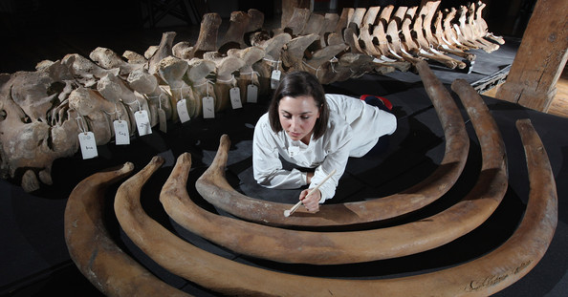
Curation
Traditionally:
Notes:
Steward of physical objects …. preservation, and meaningful arrangement of material collection …

Slide 19
Curation (defined)
(Noun)
Healing, or curing.
Guardianship.

Slide 20
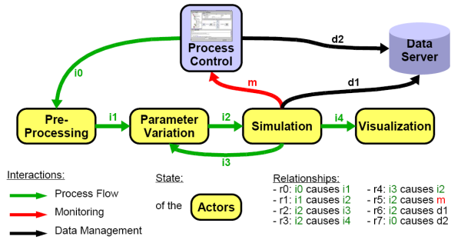
Curation in digital context
Notes:
Over time the concept has been transferred from the context of physical specimens found in natural history museums or the thematic collections of art, to a digital environment where the curatorial roles of stewardship, preservation and meaningful arrangement have taken on new meanings (Weber et al, 2013).
In a scholarly environment curatorial roles include developing indexing systems, metadata standards, ontologies, and retrieval systems that will make it possible for research data to work in concert with existing digital libraries, archives, and repositories (Palmer, Renear and Cragin, 2007). Increasingly, this work is aimed at improving data quality, guaranteeing authentication of digital resources throughout a lifecycle of us e and reuse, and capturing provenance of scholarly activities using workflow technologies.

Slide 21
Management
Plan for collection, analysis, archiving stages of research
File naming convention
Version control system
Storage redundancy
Archiving / Deleting

Slide 22
Presentation
Data structure (database, format, etc)
Cleaning / Normalizing of data
Publication (on the web, in domain repository)
Figures and Tables for journal publication

Slide 23
Preservation
Long-term storage that ensures
Bit-stream preservation
Audit files
Migration of content to new media

Slide 24
What this session will include:
What is Data Curation
Why do data curation?
Core Concepts in Data Curation
Management
Presentation
Preservation
Overview of Life Cycle models
DCC
OAIS
Notes:
This will give us a shared vocabulary, and a point of reference for the rest of the workshop … if you take notes –start now

Slide 25
“The active and on-going management of data through its lifecycle of use, including preservation and re-use”
GLSIS Definition

Slide 26
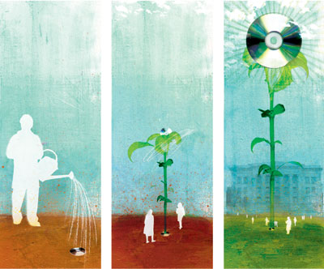
“How do your data grow?”
From
Lynch, 2008
Notes:
Research data don’t spontaneously genreate – they’re created through research, and over time.
- Lifecycle models giveus an evolutionary metaphor and model

Slide 27
Why lifecycles?
“much of the most crucial information required for effective long-term curation and reuse must be captured at the conceptualisation and collection stages." - (IDCC, 2014)
We need more than a finished data product to curate a finished data product. Lifecycle models help provide context.

Slide 28
Lifecycle Review
Two models, different scales
OAIS Reference Model
Model of repository actions
DCC lifecycle
Model of data production and curatorial workflows

Slide 29

OAIS Reference Model

Slide 30
OAIS Reference Model
ISO 14721:2003
conceptual framework of a preservation system
accommodates both digital and analog data
Prioritizes information for a ‘designated community’
A vocabulary of “terms that are not already overloaded with meaning so as to reduce conveying unintended meanings”

Slide 31
An OAIS vs. the OAIS Reference Model
An Open Archival Information System (OAIS) is an archive made up of people and systems preserving information for a Designated Community
The OAIS Reference Model is a “conceptual framework” of an OAIS (Lavoie 2000)

Slide 32
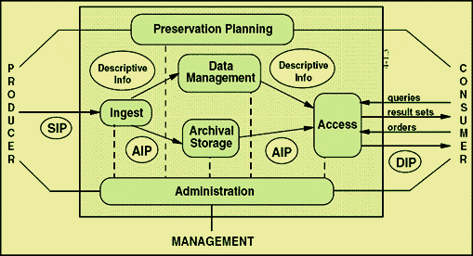
OAIS Reference Model
Notes:
Created by Consultive Committee for Space Data Systems (CCSDS) for use with space data, the OAIS Reference Model has been widely adopted by a broad range of non-space agencies as a general model of a preservation system for both analog and digital data objects.
The OAIS Reference Model provides information professionals with a conceptual framework of a preservation system, as well as a vocabulary of "terms that are not already overloaded with meaning so as to reduce conveying unintended meanings". In particular, it contributes the idea of the different information packages that are processed at different points during preservation work:
SIP: Submission information package
AIP: Archival information package
DIP: Dissemination information package
Functional Entities:
Ingest; Archival Storage; Data management; Administration; Access
Preservation activities are prioritized according to the needs of a "designated community" of users.

Slide 33
OAIS Reference Model
SIP: Submission information package
AIP: Archival information package
DIP: Dissemination information package

Slide 34
OAIS Reference Model
Functional Units:
Ingest: receives information
Archival Storage: handles the storage, maintenance and retrieval of the AIPs held by the archive
Data management: maintains and administers the database containing description information about AIPs
Administration: manages day-to-day function of the archive
Access: Helps consumers identify and obtain information in the archive

Slide 35
Benefits of the OAIS Reference Model
Broadly adopted by a range of institutions
Provides common terminology
Concentrating on the needs of a “designated community” can help focus curatorial goals and priorities

Slide 36
DCC Lifecycle Model

Slide 37

DCC Lifecycle Model
Models a data object’s “life” (creation, use) both before and after its ingest to a preservation system
Developed by the Digital Curation Centre
Divides curatorial tasks into three nested categories

Slide 38
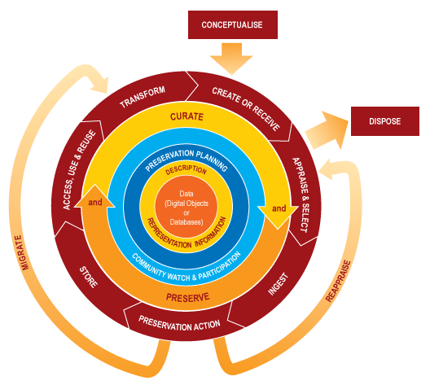
Notes:
Tell everyone to pull this up so you have it when I’m speaking
Divided into full life cycle, sequential and ocasional actions
Yes, this looks complicated but we’ll go over all of these

Slide 39
Full lifecycle actions

Slide 40
Full Lifecycle Actions
Preservation Planning: Plan for preservation throughout the curation lifecycle of digital material. This would include plans for management and administration of all curation lifecycle actions.
Community Watch and Participation: Maintain a watch on appropriate community activities, and participate in the development of shared standards, tools and suitable software.

Slide 41
Full Lifecycle Actions
Curate and Preserve: Be aware of, and undertake management and administrative actions planned to promote curation and preservation throughout the curation lifecycle.
Description and Representation Information:
Assign administrative, descriptive, technical, structural and preservation metadata, using appropriate standards, to ensure adequate description and control over the long-term.
Collect and assign representation information required to understand and render both the digital material and the associated metadata.

Slide 42
Full lifecycle actions
Sequential actions

Slide 43
Sequential Actions
Conceptualise: Conceive and plan the creation of data, including capture method and storage options.
Create or Receive: Create data including administrative, descriptive, structural and technical metadata. Preservation metadata may also be added at the time of creation. Receive data, in accordance with documented collecting policies, from data creators, other archives, repositories or data centres, and if required assign appropriate metadata.
Appraise and Select: Evaluate data and select for long-term curation and preservation. Adhere to documented guidance, policies or legal requirements.

Slide 44
Sequential Actions
Ingest: Transfer data to an archive, repository, data centre or other custodian. Adhere to documented guidance, policies or legal requirements.
Preservation Action: Undertake actions to ensure long-term preservation and retention of the authoritative nature of data. Preservation actions should ensure that data remains authentic, reliable and usable while maintaining its integrity. Actions include data cleaning, validation, assigning preservation metadata, assigning representation information and ensuring acceptable data structures or file formats.

Slide 45
Sequential Actions
Store: Store the data in a secure manner adhering to relevant standards.
Access, Use and Reuse: Ensure that data is accessible to both designated users and reusers, on a day-to-day basis. This may be in the form of publicly available published information. Robust access controls and authentication procedures may be applicable.
Transform: Create new data from the original, for example: by migration into a different format, or by creating a subset, by selection or query, to create newly derived results, perhaps for publication

Slide 46
Full lifecycle actions
Sequential actions
Occasional actions

Slide 47
Occasional Actions
Conceptualise
Reappraisal: Return data which fails validation procedures for further appraisal and re-selection.
Migration: Migrate data to a different format. This may be done to accord with the storage environment or to ensure the data's immunity from hardware or software obsolescence.
Disposal: Dispose of data, which has not been selected for long-term curation and preservation in accordance with documented policies, guidance or legal requirements.... The data's nature may, for legal reasons, necessitate secure destruction.
Notes:
Some are indidual actions, some are isntitutional, some aren’t your problem
Disposal, for example, should be driven by policy

Slide 48
All actions are centered on the data object
Full lifecycle actions
Sequential actions
Occasional actions

Slide 49
All actions are centered on the data object
Full lifecycle actions
Sequential actions
Occasional actions

Slide 50
Benefits of DCC model
Remains library/archive focused while also representing earlier stages of data work
Generalized without being too broad
Helps break curatorial tasks into individual steps
Great for administrators – comprehensive way of showing what you want to do

Slide 51
Applications of DCC and OAIS models
Can help guide policy and data curation workflows
Can help guide metadata creation
We’ll discuss this further on Day 2

Slide 52
Provenance
Day 1

Slide 53
Provenance is about the context of a records production, use, and ownership.
In short “…the significance of archival materials is heavily dependent on the context of their creation, and that the arrangement and description of these materials should be directly related to their original purpose and function.”

Slide 54
Provenance in Data Curation
Data provenance - a type of metadata that “pertains to the derivation history of a data product starting from its original sources.”
(Simmhan Plale and Gannon, 2005)
Notes:
We have the same

Slide 55
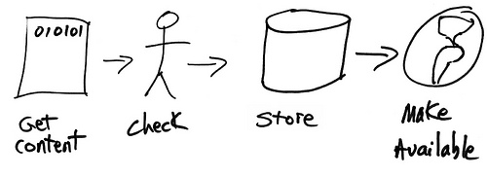
Data Provenance
Image from: leadership2013.thatcamp.org

Slide 56
Data Provenance
“…information about entities, activities, and people involved in producing a piece of data or thing, which can be used to form assessments about its quality, reliability or trustworthiness.” W3C Provenance Incubator Group
http://www.w3.org/TR/prov-dm/

Slide 57
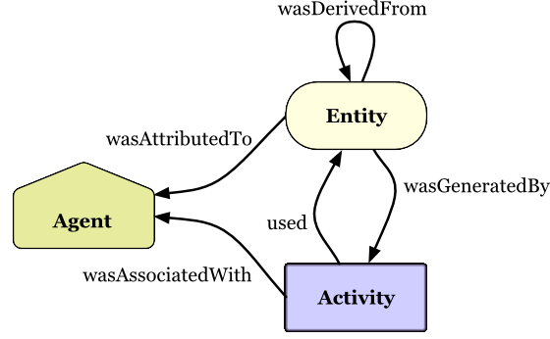
Prov-O
Notes:
Will talk more about this on day three….

Slide 58
Example of Provenance

Slide 59
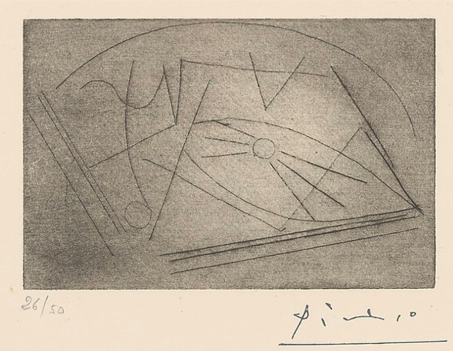
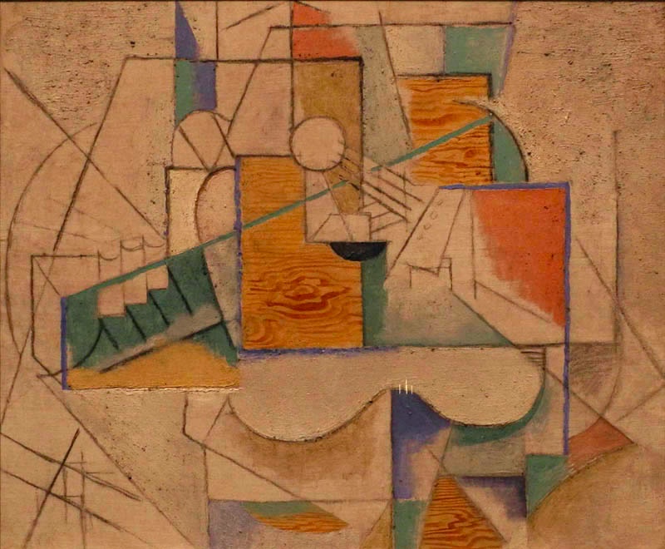
Provenance of ‘Guitar on a Table’

Slide 60
Provenance of ‘Guitar on a Table’
This painting was acquired by Gertrude Stein (American, 1874-1946, in Paris after 1902) directly from the artist. After Stein died, her collection was entrusted to her companion, Alice B. Toklas (American, 1877-1967, in Paris after 1907) until her death. Guitar on a Table was bought by Nelson A. Rockefeller in 1968 from Stein's estate. The painting was donated to Dartmouth College by Rockefeller, an alumnus of the college, in 1975. The painting has hung at the Hood Museum of Art since the building opened to the public, in 1985.
Notes:
This is less straight forward – we have information that is more general, deeper – and more difficult to put in machine readable formats for using
Source: http://hoodmuseum.dartmouth.edu/collections/overview/europe/provenance/provenancesample.html

Slide 61
Descriptive Metadata
<creator> Pablo Picasso, Spanish, 1881-1973, in Paris after 1904
<title> Guitar on a Table
<date> 1912
<medium> Oil, sand, and charcoal on canvas
<size> 20 1/8 x 24 1/4 in (51.1 x 61.6 cm)
<origin> Gift of Nelson A. Rockefeller, Class of 1930; P.975.79

Slide 62
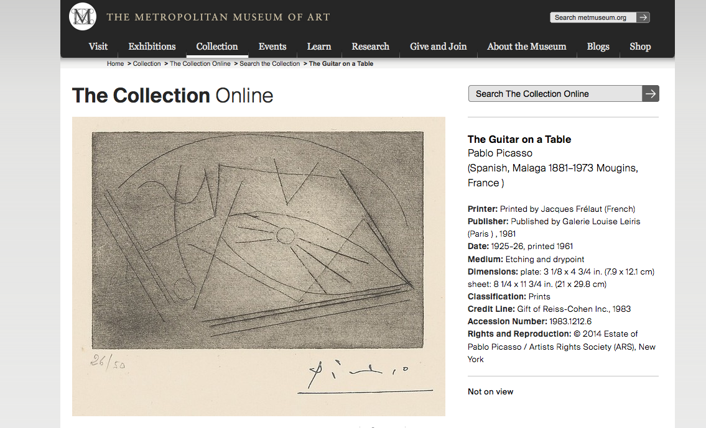
Notes:
Same exact banem aytgiyr ,,,,, sketch for the painting,… but look at the date --- what is going on here?
http://www.metmuseum.org/collection/the-collection-online/search/369777

Slide 63
References and Resources
Lavoie, 2000. Meeting the challenges of digital preservation: The OAIS reference model. OCLC Research Report. http://www.oclc.org/research/publications/library/2000/lavoie-oais.html

